Slide 1
COMP 2710 Software Construction
Linked Data Structures
Dr. Alvin Lim
Auburn University
http://www.eng.auburn.edu/~lim
limalvi@auburn.edu
Fall 2014
These slides are adapted from notes by Dr. Walter Savitch (UCSD)
Notes:
Nodes and Linked Lists
Creating, searching
Linked List Applications
Stacks, queues, sets, hash tables
Friend classes, alternatives
Iterators
Pointers as iterators
Trees

Slide 2
Introduction
Linked list
  Constructed using pointers
  Grows and shrinks during run-time
  Doubly Linked List : A variation with pointers in both directions
Trees also use pointers
Pointers backbone of such structures
  Use dynamic variables
Standard Template Library
  Has predefined versions of some structures
Copyright © 2008 Pearson Addison-Wesley. All rights reserved.
17-<number>

Slide 3
Approaches
Three ways to handle such data structures:
  C-style approach: global functions and
  structs with everything public
  Classes with private member variables and
  accessor and mutator functions
  Friend classes
Linked lists will use method 1
Stacks, queues, sets, and hash tables will use method 2
Trees will use method 3
Copyright © 2008 Pearson Addison-Wesley. All rights reserved.
17-<number>

Slide 4
Nodes and Linked Lists
Linked list
  Simple example of "dynamic data structure"
  Composed of nodes
Each "node" is variable of struct or class
type that’s dynamically created with new
  Nodes also contain pointers to other nodes
  Provide "links"
Copyright © 2008 Pearson Addison-Wesley. All rights reserved.
17-<number>

Slide 5
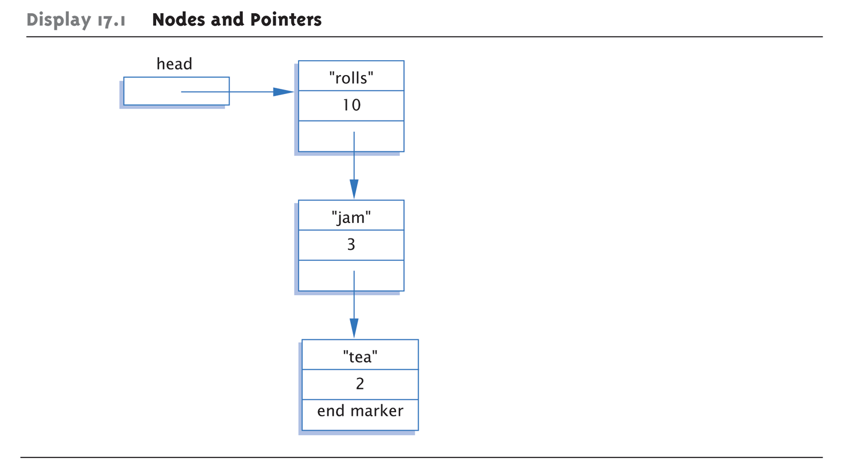
Display 17.1 Nodes and Pointers
Copyright © 2008 Pearson Addison-Wesley. All rights reserved.
17-<number>

Slide 6
Node Definition
struct ListNode
{
string item;
int count;
ListNode *link;
};
typedef ListNode* ListNodePtr;
Order here is important!
  Listnode defined 1st, since used in typedef
Also notice "circularity"
Copyright © 2008 Pearson Addison-Wesley. All rights reserved.
17-<number>

Slide 7
Head Pointer
Box labeled "head" not a node:
ListNodePtr head;
  A simple pointer to a node
  Set to point to 1st node in list
Head used to "maintain" start of list
Also used as argument to functions
Copyright © 2008 Pearson Addison-Wesley. All rights reserved.
17-<number>

Slide 8
Example Node Access
(*head).count = 12;
  Sets count member of node pointed to by
  head equal to 12
Alternate operator, ->
  Called "arrow operator"
  Shorthand notation that combines * and .
  head->count = 12;
    Identical to above
cin >> head->item;
  Assigns entered string to item member
Copyright © 2008 Pearson Addison-Wesley. All rights reserved.
17-<number>

Slide 9
End Markers
Use NULL for node pointer
  Considered "sentinel" for nodes
  Indicates no further "links" after this node
Provides end marker similar to how we
use partially-filled arrays
Copyright © 2008 Pearson Addison-Wesley. All rights reserved.
17-<number>

Slide 10
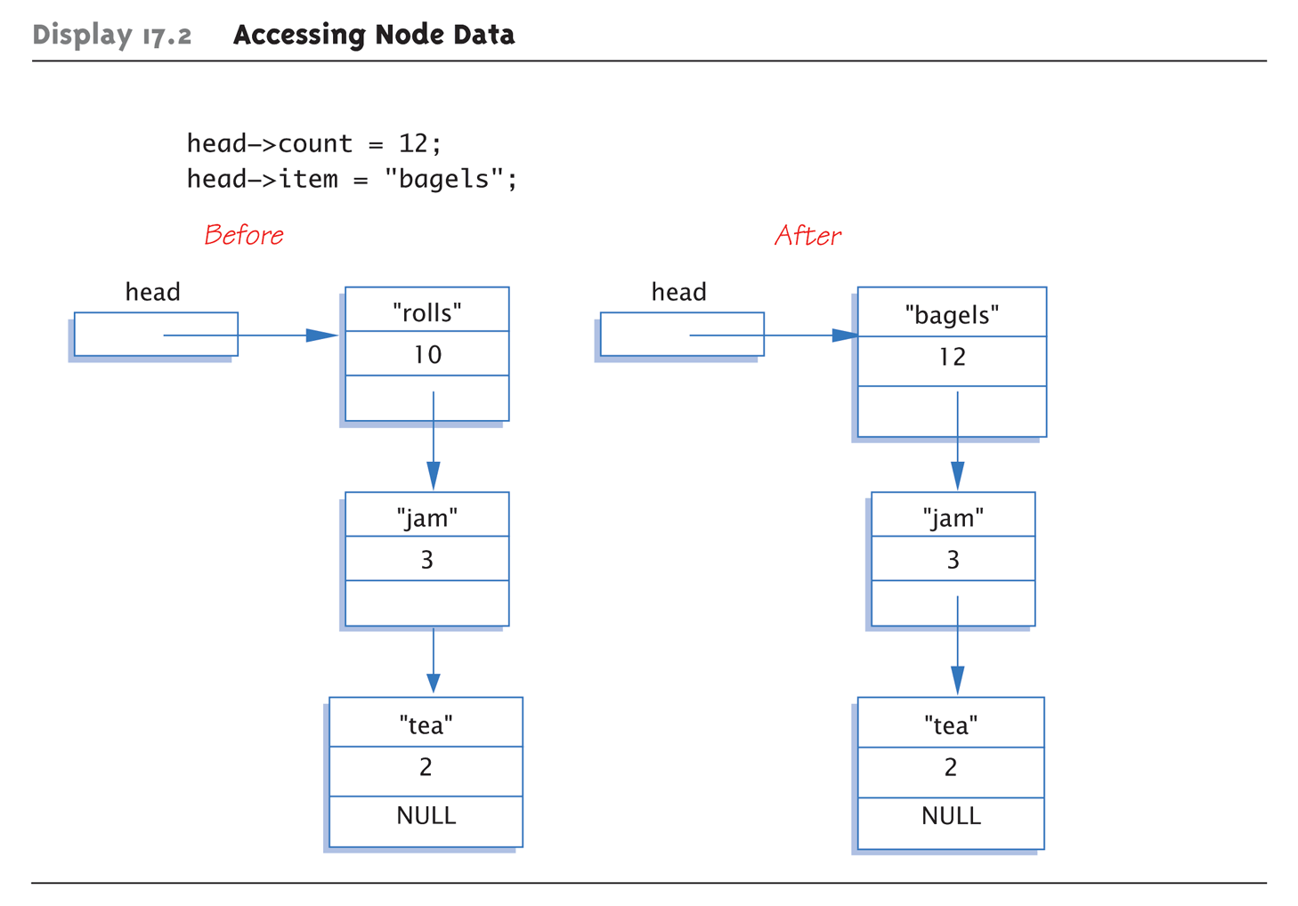
Display 17.2 Accessing Node Data
Copyright © 2008 Pearson Addison-Wesley. All rights reserved.
17-<number>

Slide 11
Linked List
Lists as illustrated called linked lists
First node called head
  Pointed to by pointer named head
Last node special also
  It’s member pointer variable is NULL
  Easy test for "end" of linked list
Copyright © 2008 Pearson Addison-Wesley. All rights reserved.
17-<number>

Slide 12
Linked List Class Definition
class IntNode
{
public:
IntNode() { }
IntNode(int theData, IntNOde* theLink)
: data(theData), link(theLink) { }
IntNode* getLink() const {return link;}
int getData() const {return data;}
void setData(int theData) {data = theData;}
void setLink(IntNode* pointer) {link=pointer;}
private:
int data;
IntNode *link;
};
typedef IntNode* IntNodePtr;
Copyright © 2008 Pearson Addison-Wesley. All rights reserved.
17-<number>

Slide 13
Linked List Class
Notice all member function definitions are inline
  Small and simple enough
Notice two-parameter constructor
  Allows creation of nodes with specific data
  value and specified link member
  Example:
  IntNodePtr p2 = new IntNode(42, p1);
Copyright © 2008 Pearson Addison-Wesley. All rights reserved.
17-<number>

Slide 14
Create 1st Node
IntNodePtr head;
  Declares pointer variable head
head = new IntNode;
  Dynamically allocates new node
  Our 1st node in list, so assigned to head
head->setData(3);
head->setLink(NULL);
  Sets head node data
  Link set to NULL since it’s the only node!
Copyright © 2008 Pearson Addison-Wesley. All rights reserved.
17-<number>

Slide 15
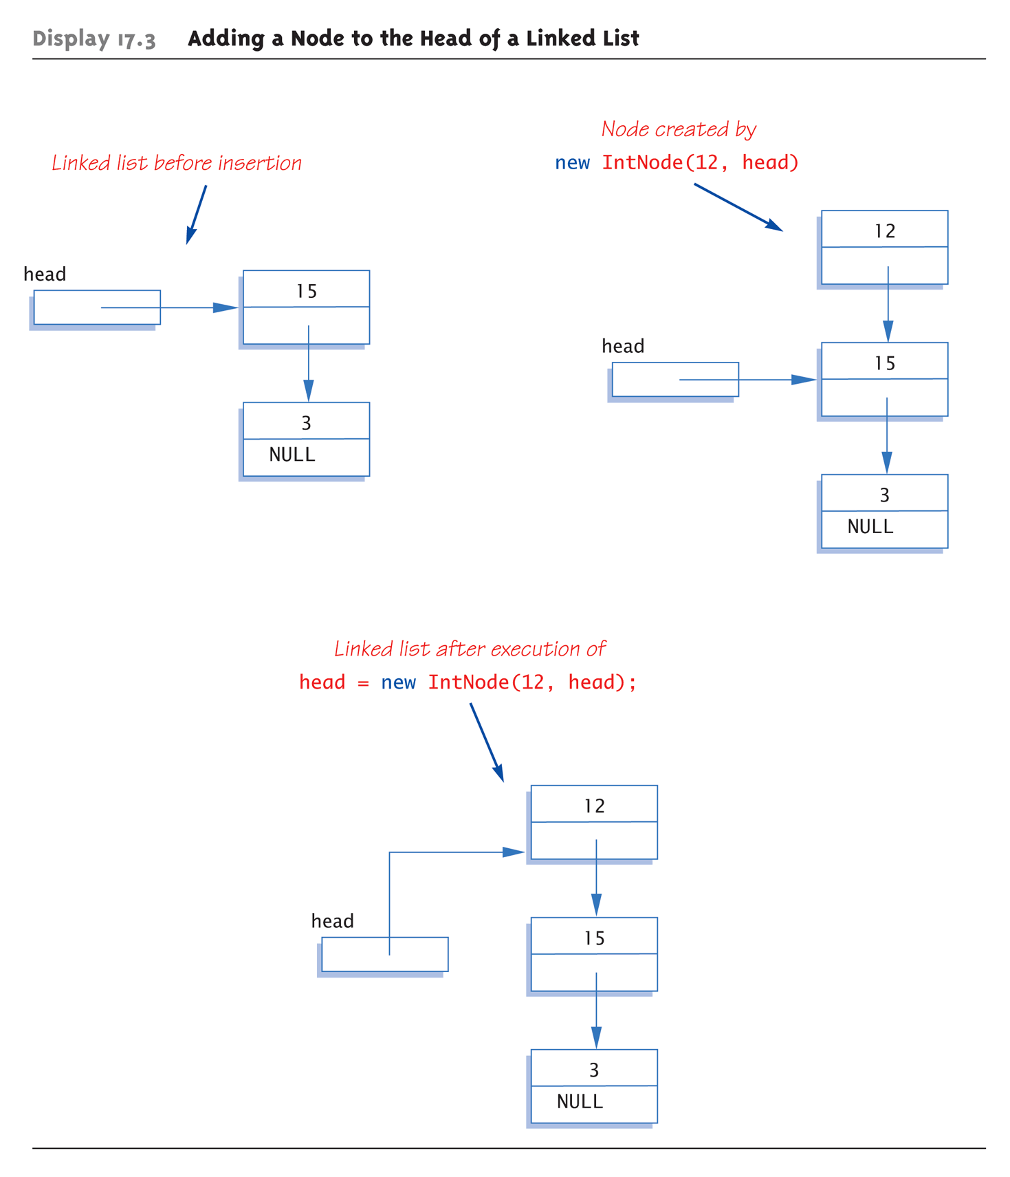
Display 17.3 Adding a Node to the Head of a Linked List
Copyright © 2008 Pearson Addison-Wesley. All rights reserved.
17-<number>

Slide 16
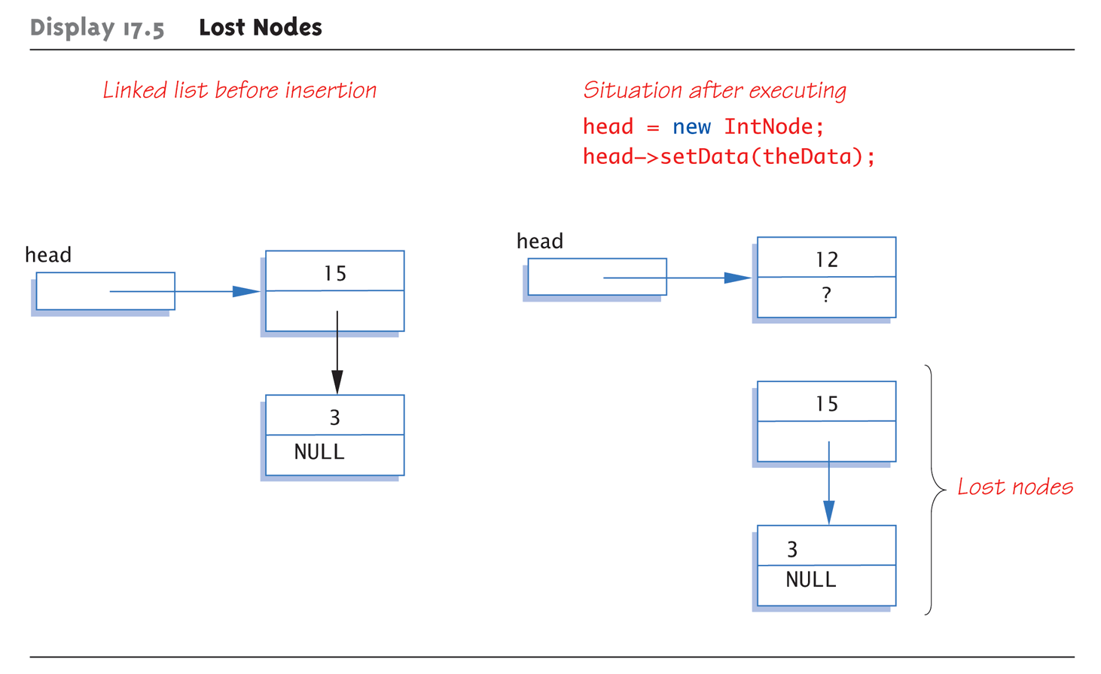
Lost Nodes Pitfall:
Display 17.5 Lost Nodes
Copyright © 2008 Pearson Addison-Wesley. All rights reserved.
17-<number>

Slide 17
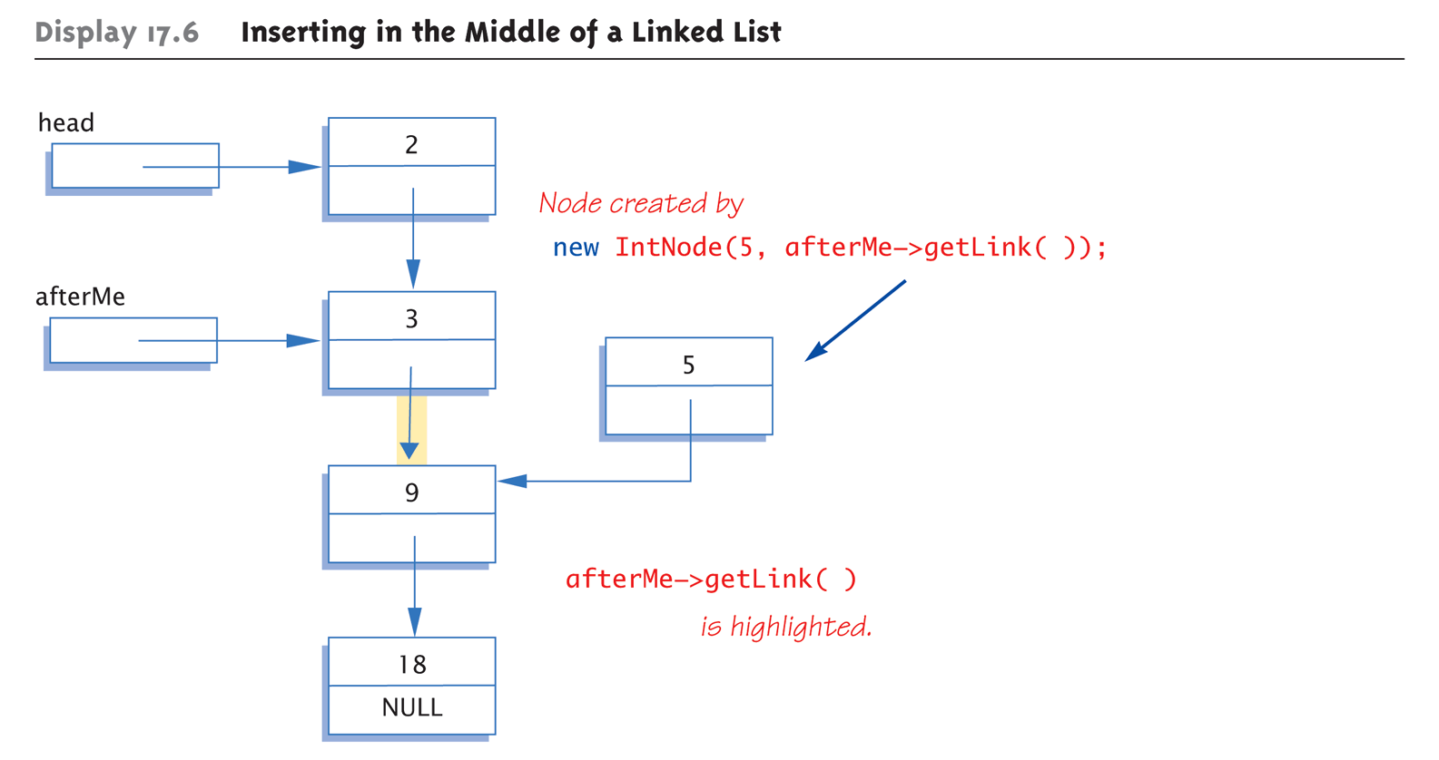
Display 17.6 Inserting in the Middle of a Linked List (1 of 2)
Copyright © 2008 Pearson Addison-Wesley. All rights reserved.
17-<number>

Slide 18
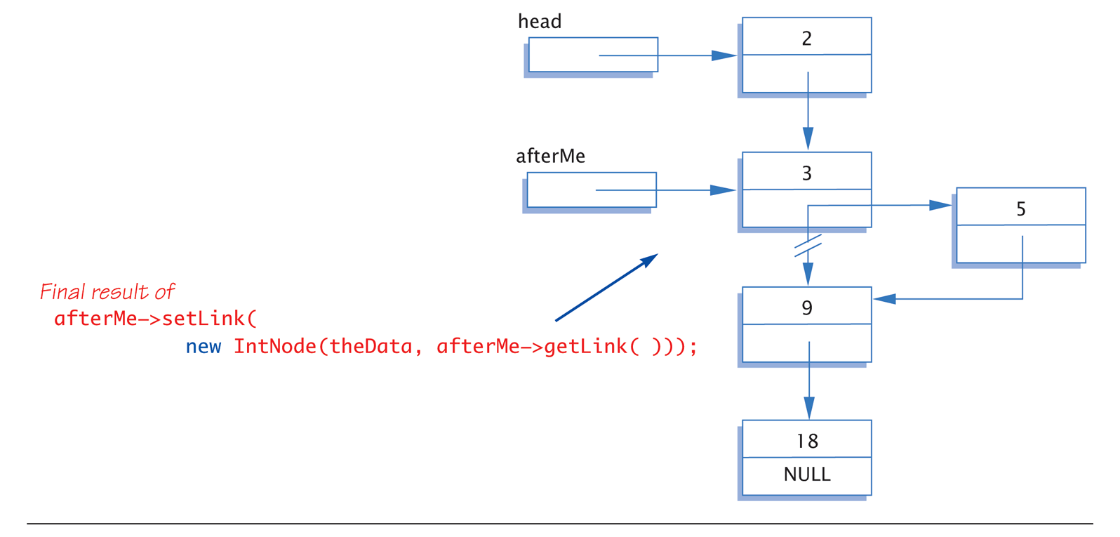
Display 17.6 Inserting in the Middle of a Linked List (2 of 2)
Copyright © 2008 Pearson Addison-Wesley. All rights reserved.
17-<number>

Slide 19
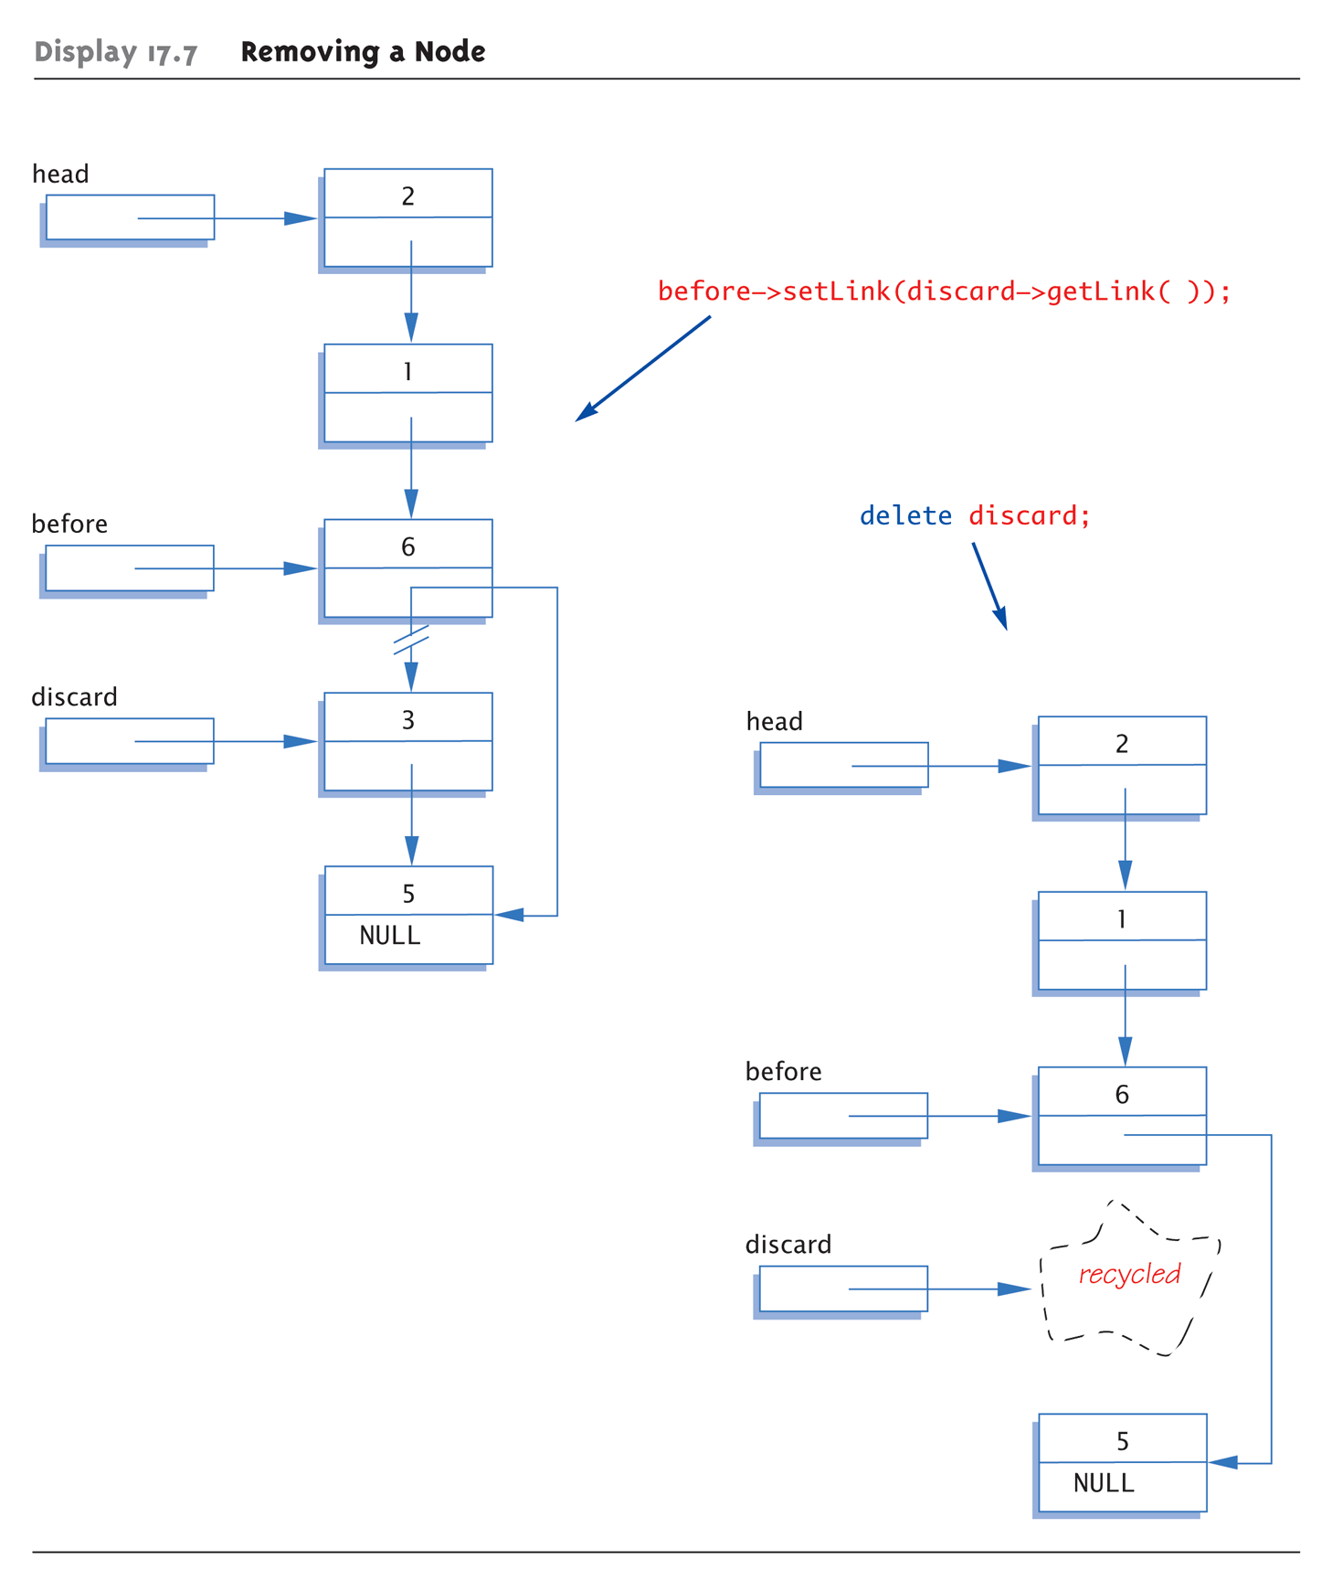
Display 17.7 Removing a Node
Copyright © 2008 Pearson Addison-Wesley. All rights reserved.
17-<number>

Slide 20
Searching a Linked List
Function with two arguments:
IntNodePtr search(IntNodePtr head, int target);
//Precondition: pointer head points to head of
//linked list. Pointer in last node is NULL.
//If list is empty, head is NULL
//Returns pointer to 1st node containing target
//If not found, returns NULL
Simple "traversal" of list
  Similar to array traversal
Copyright © 2008 Pearson Addison-Wesley. All rights reserved.
17-<number>

Slide 21
Pseudocode for search Function
while (here doesn’t point to target node or
last node)
{
Make here point to next node in list
}
if (here node points to target)
return here;
else
return NULL;
Copyright © 2008 Pearson Addison-Wesley. All rights reserved.
17-<number>

Slide 22
Algorithm for search Function
while (here->getData() != target &&
here->getLink() != NULL)
here = here->getLink();
if (here->getData() == target)
return here;
else
return NULL;
Must make "special" case for empty list
  Not done here
Copyright © 2008 Pearson Addison-Wesley. All rights reserved.
17-<number>

Slide 23
Doubly Linked Lists
What we just described is a singly linked list
  Can only follow links in one direction
Doubly Linked List
  Links to the next node and another link to the previous node
  Can follow links in either direction
  NULL signifies the beginning and end of the list
  Can make some operations easier, e.g. deletion since we don’t need to search the list to find the node before the one we want to remove
Copyright © 2008 Pearson Addison-Wesley. All rights reserved.
17-<number>

Slide 24
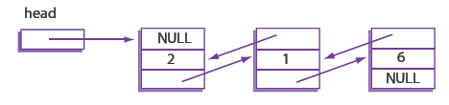
Doubly Linked Lists
class DoublyLinkedIntNode
{
public:
DoublyLinkedIntNode ( ){}
DoublyLinkedIntNode (int theData, DoublyLinkedIntNode* previous,
DoublyLinkedIntNode* next)
: data(theData), nextLink(next), previousLink(previous) {}
DoublyLinkedIntNode* getNextLink( ) const { return nextLink; }
DoublyLinkedIntNode* getPreviousLink( ) const { return previousLink; }
int getData( ) const { return data; }
void setData(int theData) { data = theData; }
void setNextLink(DoublyLinkedIntNode* pointer) { nextLink = pointer; }
void setPreviousLink(DoublyLinkedIntNode* pointer)
{ previousLink = pointer; }
private:
int data;
DoublyLinkedIntNode *nextLink;
DoublyLinkedIntNode *previousLink;
};
typedef DoublyLinkedIntNode* DoublyLinkedIntNodePtr;
Copyright © 2008 Pearson Addison-Wesley. All rights reserved.
17-<number>

Slide 25
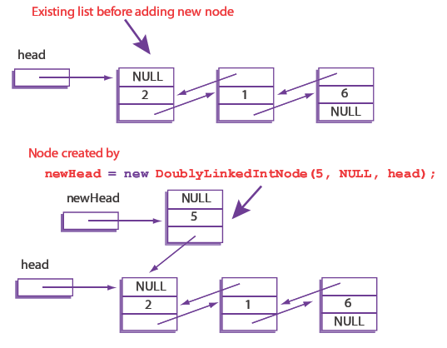
Adding a Node to the Front of a Doubly Linked List (1 of 2)
Copyright © 2008 Pearson Addison-Wesley. All rights reserved.
17-<number>

Slide 26
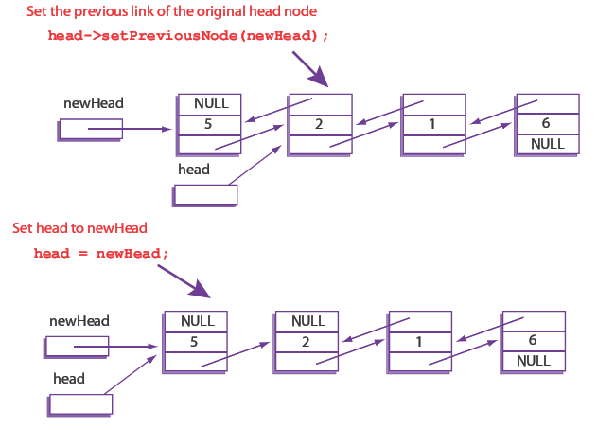
Adding a Node to the Front of a Doubly Linked List (2 of 2)
Copyright © 2008 Pearson Addison-Wesley. All rights reserved.
17-<number>

Slide 27
Deleting a Node from a Doubly Linked List
Removing a node requires updating references on both sides of the node we wish to delete
Thanks to the backward link we do not need a separate variable to keep track of the previous node in the list like we did for the singly linked list
  Can access via node->previous
Copyright © 2008 Pearson Addison-Wesley. All rights reserved.
17-<number>

Slide 28
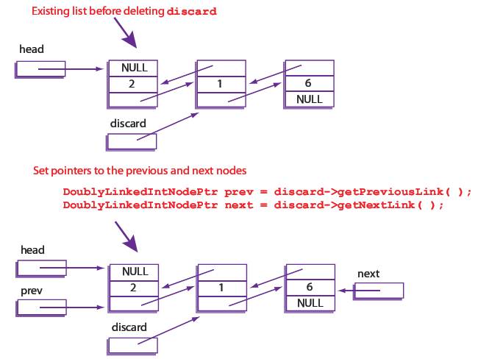
Deleting a Node from a Doubly Linked List (1 of 2)
Copyright © 2008 Pearson Addison-Wesley. All rights reserved.
17-<number>

Slide 29
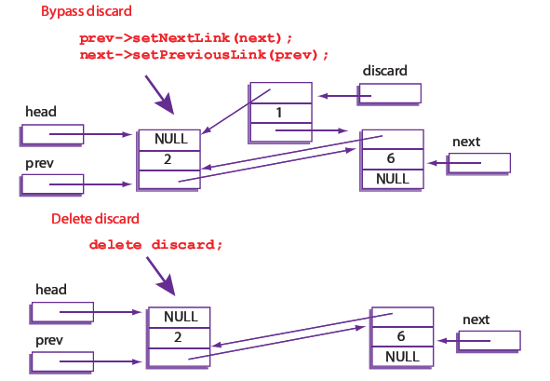
Deleting a Node from a Doubly Linked List (2 of 2)
Copyright © 2008 Pearson Addison-Wesley. All rights reserved.
17-<number>

Slide 30
Summary
Node is struct or class object
  One or more members is pointer
  Nodes connected by member pointers
    Produce structures that grow and shrink at runtime
Linked list
  List of nodes where each node points to next
  In a doubly linked lists there are pointers in both directions
End of linked list marked with NULL pointer
Copyright © 2008 Pearson Addison-Wesley. All rights reserved.
17-<number>

